Slide 1
Minds, Machines, Persons
The Mechanical Worldview

Slide 2
Overview
The shift from the organic worldview to the mechanical worldview
Potential obstacles to the mechanical worldview
The Mechanical Mind Thesis:
What it means
Its implications
Its (initial) plausibility

Slide 3
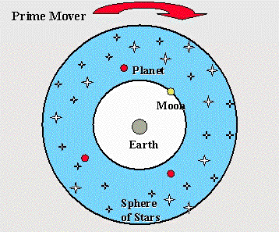
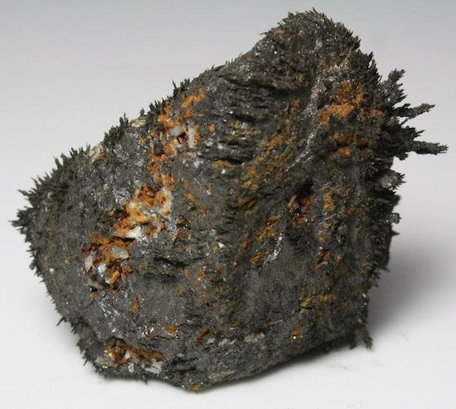
The “Organic” Worldview
Dominant worldview for roughly 2000 years
The world is like one large organism
Everything is a proper part of this giant organism (Mother Earth)
Some believed there was a World soul (God) to accompany the “body”
Heavily influenced by the work of Aristotle and other ancient Greeks
Explanations appealed to final causes (goals, purposes of objects)
Physics/Chemistry (goals of elements)
Biology (goals of plants and animals)
All things that move (other than artifacts) are, to some degree, alive
Animation as the mark of the living
Lodestones were believed to be living things (Thales, Plato, Aristotle*)
Notes:
Rocks strive to reach the center of the universe (that’s why they fall)
Fire strives to move away from the center of the universe
Stars strive to move in perfect circles
Seeds strive to grow into a tree
Frogs strive to reproduce to create more frogs

Slide 4
Supernaturalism and Early Science
Supernatural explanations or appeals to magic were also common in the 17th century
Astrology: the behavior of planets has a causal influence on human behavior (shapes personality traits)
Planets were believed to have minds
Telekinesis on an astronomical scale
Alchemy: the transformation of matter is mysterious (no rational explanation for why chemicals behave the way they do)
Trial and error with the goal of transforming common metals into gold
Medicine: some human ailments are caused by the possession of supernatural entities (e.g. demons)
Exorcism as medical treatment for possession

Slide 5
The shift away from the O.W
A “mechanical” understanding of the world became influential in the 17th century
The world is a machine, not an organism
Technological inventions allowed for an understanding of how non-living things can be designed to move on their own, and revealed hidden mechanisms in nature
Minute-hand watch (1577)
Microscope (1590)
Telescope (1608)
Mechanistic accounts of physics and astronomy were the first to develop
Sunspots and the rings of Saturn
Response: There cannot be such imperfections! The telescope must be an unreliable instrument
Newtonian mechanics much more successful (e.g. predictive power) than earlier physical theories (e.g. Aristotelian mechanics)

Slide 6
The Mechanical Worldview
The behavior of the world can be understood in terms of causal mechanisms governed by laws of nature
The world consists of material particles (or corpuscles) in motion
Experiments conducted to discover the laws of nature, expressible in the language of mathematics
Mechanical explanations in physics
Rejection of Aristotelian explanations (final causes)
A.E: Each object has its own special powers that explain their movement
M.E: There are general laws that govern or describe the movement objects
Newton’s laws of motion
The Mechanical Worldview is still the dominant framework in science

Slide 7
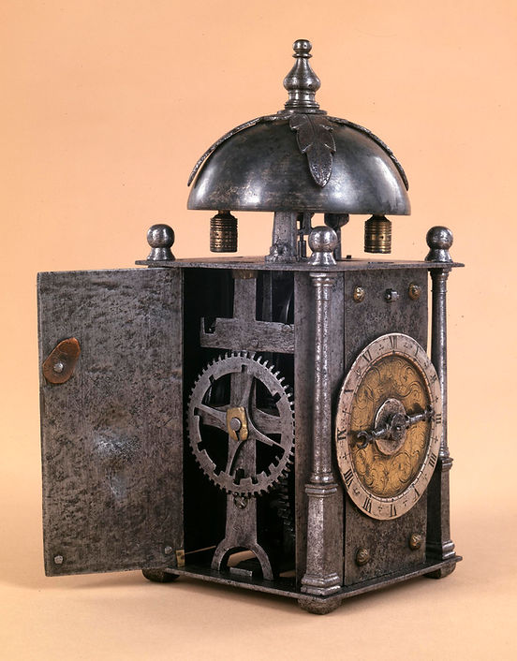
The Clock Metaphor
Clocks were familiar and complex artifacts that were completely intelligible
Exhibit uniform and regular behaviors
The causal mechanisms that drove behavior were often hidden
Kepler: “I am much occupied with the investigation of the physical causes. My aim in this is to show that the machine of the universe is not similar to a divine animated being, but similar to a clock”
Robert Boyle: The natural world is “as it were, a great piece of clock-work.”
La Mettrie:“‘the body is but a watch . . . man is but a collection of springs which wind each other up.’
Descartes: “there is no difference between the machines built by artisans and the diverse bodies that nature alone composes”

Slide 8
Mechanical Explanations
Mechanical explanations in chemistry
Chemicals compounds (e.g. gold) are made up of molecules with special structures
Laws of chemistry (e.g. Boyle’s gas laws)
Mechanical explanations in biology
Lifeforms should be understood as machines
Mechanism all the way down (biological systems comprised of cells)
La Mettrie:“‘the body is but a watch . . . man is but a collection of springs which wind each other up.’
How far can mechanistic explanation take us?
Can it explain everything in the world?
Can everything be explained in terms of causal mechanisms and laws of nature?

Slide 9
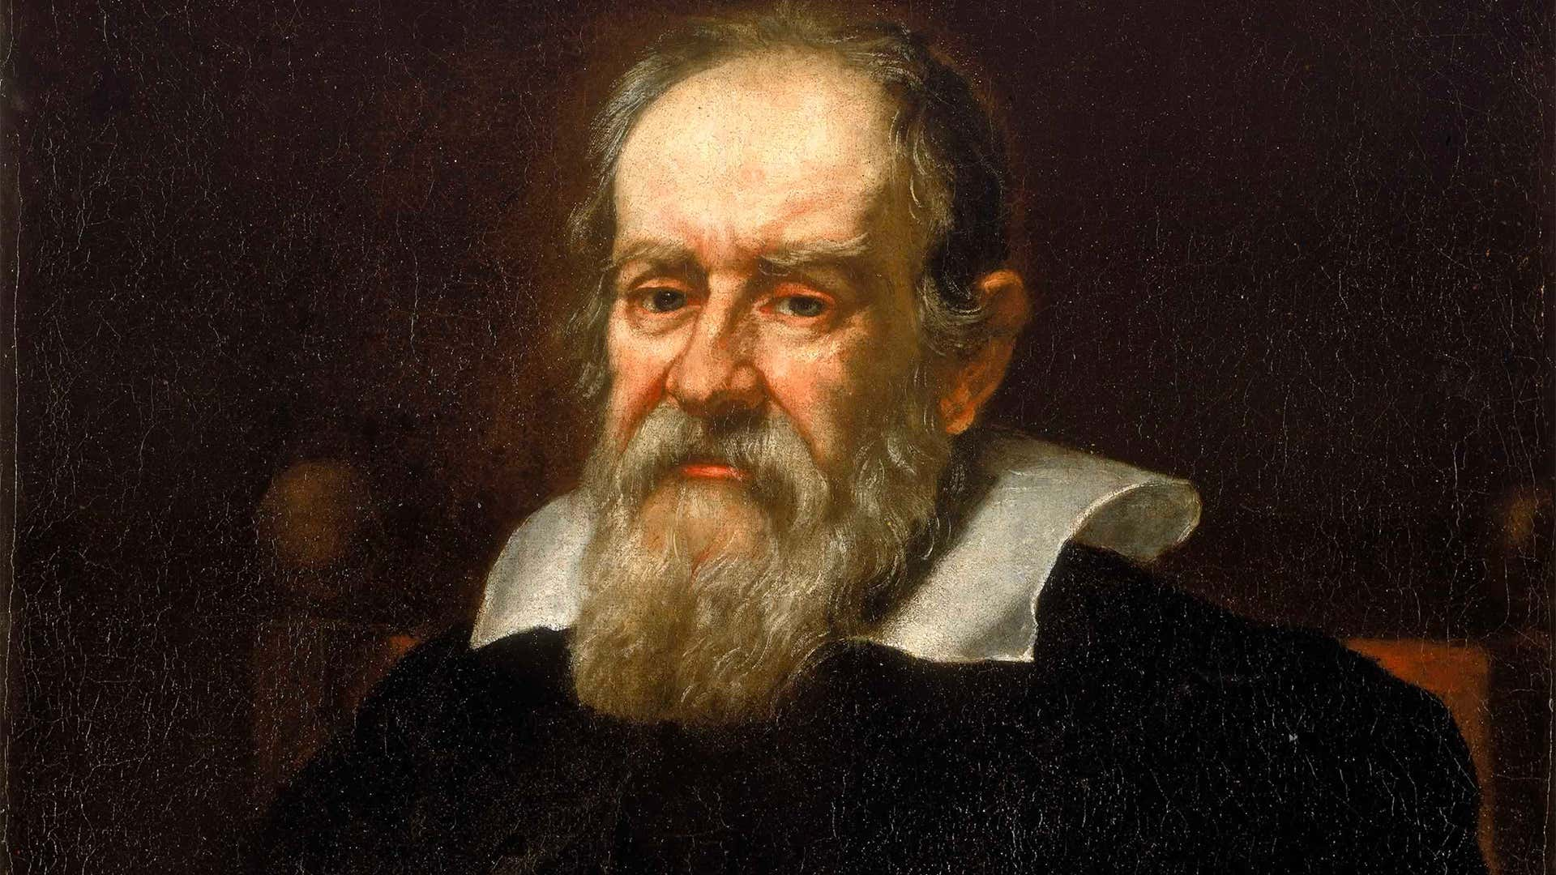
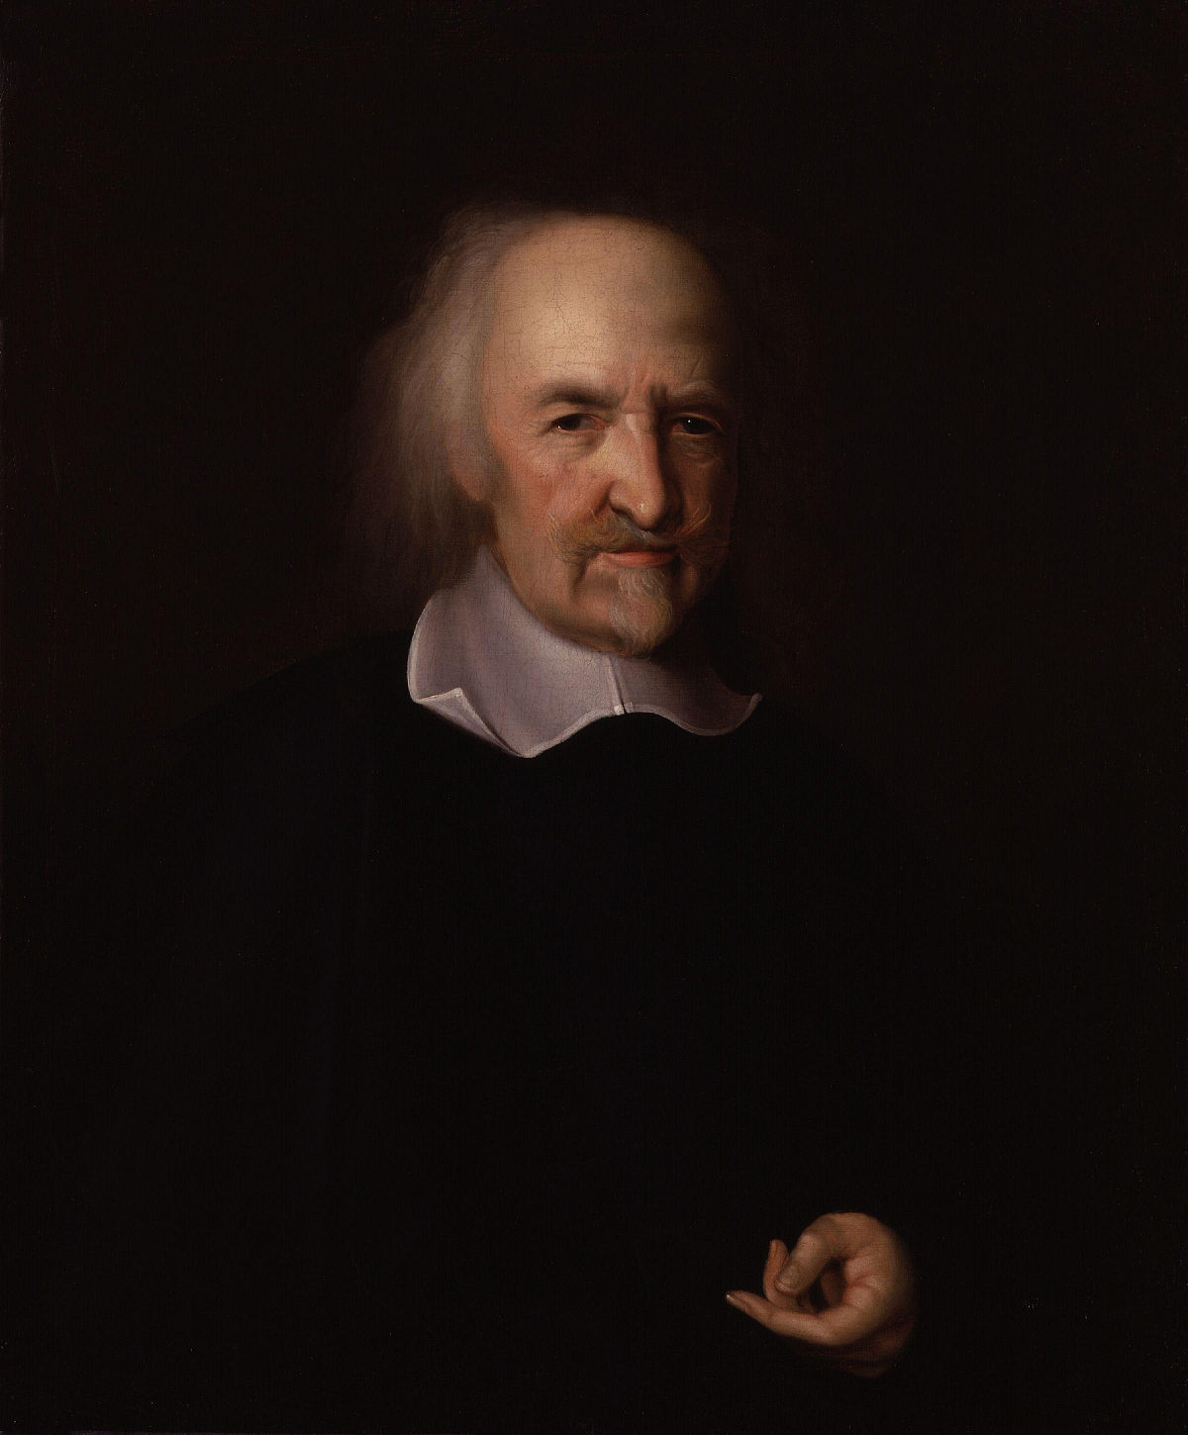
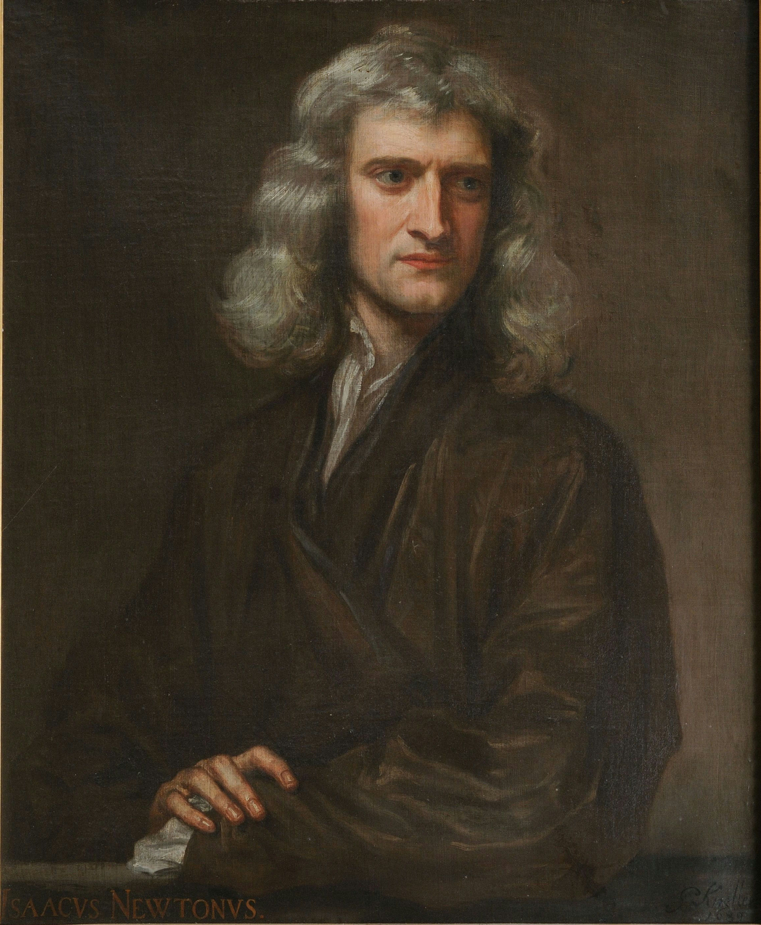
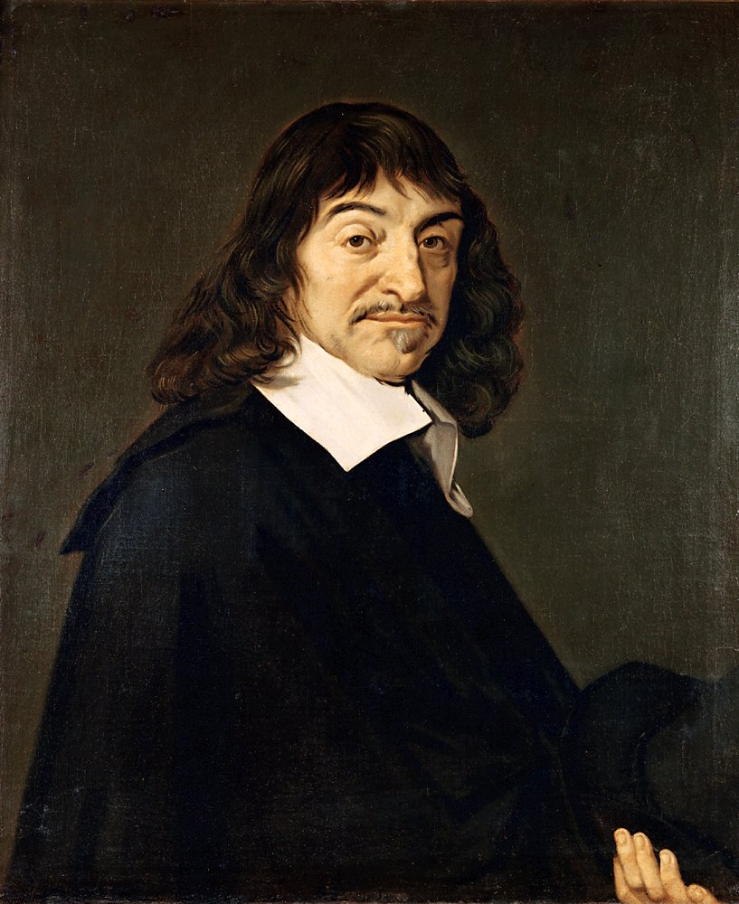
Mechanistic thinkers
Thomas Hobbes
Galileo
Newton
Pierre Laplace
Julian de La Mettrie
Rene Descartes
Notes:
Descartes believed that the mind cannot be explained mechanistically. Immaterial souls posited to explain the mind.

Slide 10


Slide 11

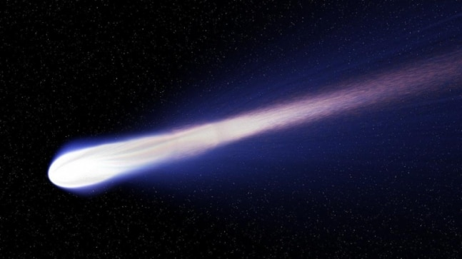
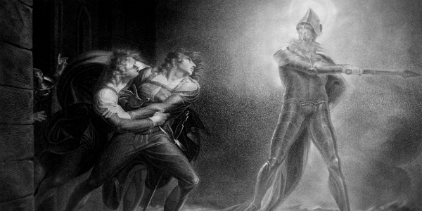
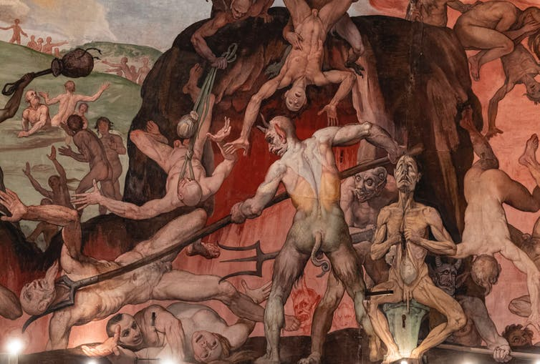
Non-mechanistic phenomena?
Potential challenges to the Mechanical Worldview:
“Occult effects”
Gravity
Magnetism
Comets
Ghosts
Demons
The transformation of matter
Life
God
The Mind

Slide 12

Occult Effects
Newton argued that gravity can be understood by positing hidden mechanisms (i.e. particles) that “act at a distance”
Newton’s contemporaries were deeply unsatisfied with his account (sounded like magic, not science)
Mechanism posited by the standard model in physics: gravitons (yet to be discovered)
Newton also posited the existence of tiny particles to explain the behavior of light
Photons have been discovered
Magnetism explained mechanistically in the 19th century
Maxwell’s unification of light, magnetism, and electricity (Electromagnetism)

Slide 13
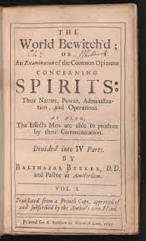
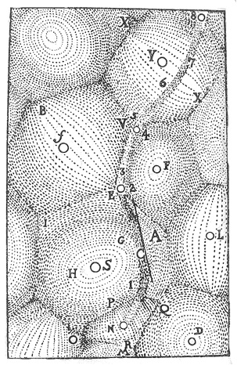
Comets, Ghosts, and Demons
In the 17th century, it was widely believed that comets had a supernatural source
God sent comets to Earth to communicate with us
Bekker argued that the behavior of comets can be explained mechanistically
Vortex theory (Descartes)
Supernatural explanation implausible (theological and empirical objections)
Bekker argued that demons and ghosts cannot have causal powers
They might exist but don’t do anything in the world
Hobbes argued that ghosts and demons were products of the mind
Ignorance of causes
Dream states or hallucinations (two possible causes)
A mechanical science of the mind will discover them
Notes:
The world bewitch’d | Balthasar Bekker (1695).

Slide 14
Life and the Mechanical Worldview
What is the difference between living and nonliving things?
In the 18th and 19th centuries, vitalists argued that life cannot be explained mechanistically
Living things have an energy or “vital force” which non-living things lack
The vital force is not made up of (physical) particles
On some versions, the vital force is a just a mystery, not subject to scientific explanation
Contemporary versions: qi, chakras, morphic resonance fields (Sheldrake)
In the mid 20th century, the field of biochemistry was established
Reproduction and other biological processes can be explained in chemical terms
Mechanistic explanations of life are now well accepted
Vitalism widely viewed as a prescientific or refuted pseudoscientific view

Slide 15
A mechanical God?
Hobbes believed everything in the world was comprised of matter
Strong defender of materialism
He also expressed belief in God
Materialist conception of God
God as an invisible fluid substance that exists throughout the universe
Indeterminate in size
Causes motion by flowing into other material bodies (direct contact)
Vast majority of theologians and philosophers of religion reject the existence of a mechanical God
God as an immaterial soul
Notes:
Most materialists are atheist, so many of his contemporaries thought he was a closeted one. Late in his career he wrote about what God might be like.

Slide 16
Descartes on Mechanism and the Human Mind
Descartes believed mechanistic explanations could account for everything in the world, except minds (e.g. humans, angels, God)
Animals are mere machines (no minds)
Followers of Descartes regularly practiced vivisection without anesthetic
Understanding of the inner workings of God’s machines
The world contains some mental entities (souls) that aren’t governed by the laws of nature
Human souls/minds aren’t bound by psychological laws
Humans have free will
Ability to do otherwise (e.g. breaking certain kinds of laws)
Choosing good over evil
Descartes’s account to be explored in detail on 9/21

Slide 18
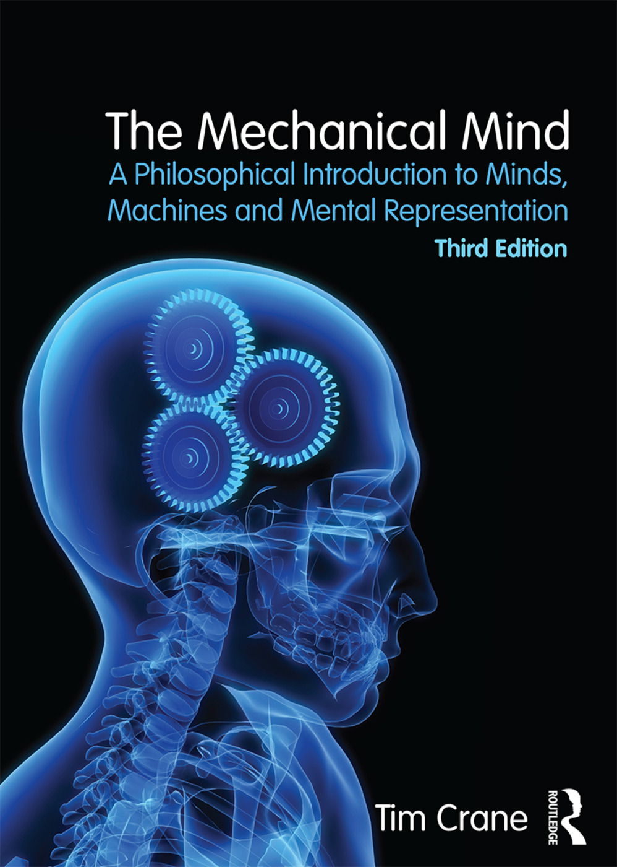
The Mechanical Mind
Thesis: The mind is a natural machine
Can be understood in terms of biological mechanisms that are governed by natural laws
Mental states are really just states of the brain
Like in physics, we can posit the existence of hidden mechanisms to explain the mind
Mental states or mental representations (theoretical entities)
Mechanisms will (likely) be located somewhere in our brains
Cognitive science provides mechanistic theories of the mind
Psychological (or mental) entities, states, and properties
Psychological laws used to predict, manipulate and explain human behavior
Jury is still out on the correct theory

Slide 19
The Mechanical Mind
Thesis: The mind is a natural machine
Assumption: We can explain the mind and its powers without appealing to supernatural entities, forces, or powers
E.g. Gods, souls, contra-causal freedom
Question: Does the mechanical mind thesis rule out belief in God?
Is theism compatible with the mechanical mind thesis?
Does it rule out other philosophical views?
Notes:
Rules out (at least certain forms of) substance dualism + libertarianism (free will)

Slide 20
Naturalism and the Supernatural
Since the scientific revolution, supernatural explanations have not been accepted as legitimate contenders
Special creation (supernatural account of the diversity of life)
Darwin’s theory of Natural Selection (natural account of the diversity of life)
Common attitude in science: we should seek natural explanations for phenomena
Methodological Naturalism
A view about the aims of scientific investigation
This is quite different from saying that only natural entities, powers, etc. exist
Metaphysical Naturalism
A view about what exists
Methodological Naturalism is compatible with Supernaturalism
Supernatural explanations viewed as a last resort (e.g. the origin of the universe)

Slide 21
Discussion questions
Instructions: Choose at least one of the following questions to answer in your notebook
Why might someone think the mechanical mind thesis is mistaken and/or incomplete?
Relevant differences between minds and machines?
Are there some things that beings with minds can do that machines will never be able to? (if so, cite specific examples)

Slide 22
Obstacles to the Mechanical Worldview
The phenomenon of consciousness
How can sensations and feelings arise from brain matter?
The hard problem of consciousness (Chalmers)
The phenomenon of thought
“How can a mere mechanism think about and represent things?”
The problem of intentionality
In this course, we will try to determine whether defenders of the Mechanical Mind thesis can overcome these obstacles

Slide 23
Next class:
Homework:
Crane Ch. 2
Podcast: Godfrey-Smith on Mental Representation
Recommended: Of Rats And Men (NPR)
Topic:
The puzzle of representation

